Slide 2
ERASMUS +
Traineeship
CHECKLIST BEFORE DEPARTURE
WHAT SHALL I DO NOW?
Edited by the International Mobility Unit – June 2024

Slide 3
The Q&A session has been planned at the end.
Please, take note of any questions you have for us!
Notes:
Ciao a tutti - welcome to our presentation on international recruiting and sustainability.

Slide 4
WHAT’S ON THE AGENDA TODAY…
Allocation acceptance
Checking entry rules
Learning Agreement
International Mobility Delegates
OLS Test
Mobility Agreement
Financial contributions
During and after the mobility (documents and deadlines)

Slide 5
ALLOCATION
Remember to accept your allocation!
Follow the instructions received via email.
Deadline: Friday, June 21 at 1 PM

Slide 6
VISA and ENTRY RULES
Inform yourself about entry rules and healthcare assistance
in the host country.
You can rely on:
Host Country Embassy
Host Institution instructions
https://www.esteri.it/it/
https://www.viaggiaresicuri.it/home
What UniPV can provide:
Certificate of Assignment
Unipv insurance policies (Accident, Civil Liability) NO HEALTH INSURANCE!!

Slide 7
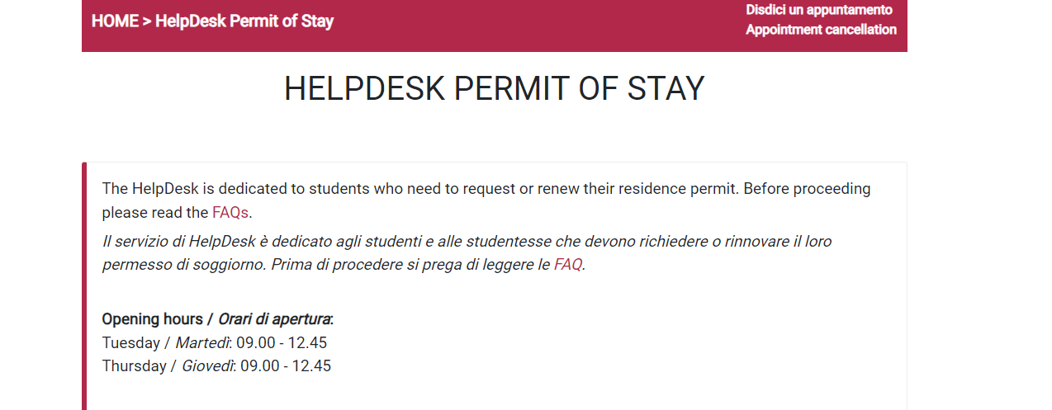
RESIDENCE PERMIT
If you are in Italy with a residence permit, make sure it remains valid for the entire period of mobility abroad. If you need to renew it, take action immediately in preparation for your Erasmus program departure. If you need assistance, contact the dedicated GOPA office: HelpDesk Permit of Stay
Start the renewal process at least 4 months before departure.
Ask the International HelpDesk at Questura offices: GOPA.

Slide 8
LEARNING AGREEMENT
The LA sets out the progamme of the activities to be followed abroad.
Before departure:
Download the Learning Agreement form from our website
Contact your host supervisor and then your International Mobility Coordinator to agree on the Learning Agreement.
Send the signed LA to the International Mobility Office (train.erasmus@unipv.it)
Mandatory details:
Data of the Trainee
Data of the International Mobility Coordinator
Data of the host supervisor
Mobility period
Programme of the traineeship (e.g. what the acceptance letter outlines)
CREDITS
Signatures

Slide 9
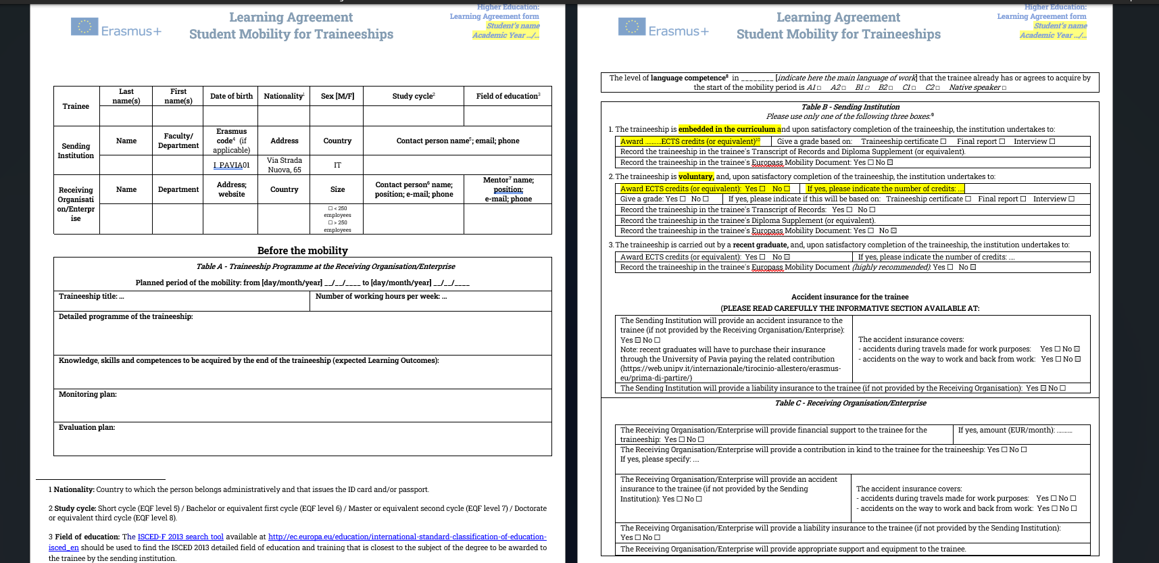
Your data
MANDATORY
Your international mobility coordinator
Host supervisor

Slide 10
LEARNING AGREEMENT
IMPORTANT: the Learning Agreement MUST be approved/signed by you, the Receiving Institution and the UniPV International Mobility Coordinator
Submission deadline: 1 month before departure
Where is the form: Internazionale --> Erasmus Traineeship --> Dopo le selezioni --> prima di partire
All signatures are MANDATORY before departure

Slide 11
INTERNATIONAL MOBILITY COORDINATORS
Internazionale > Traineeship Abroad > After the selections > Before the mobility
Supports students in drafting the Learning Agreement
Is responsible for approving the traineeship plan of the Learning Agreement before departure (and the credits)
Approves changes to the LA during mobility
Is responsible for the academic recognition of the results achieved abroad by the student.
Notes:
Still waiting for the full list of the mobility representatives.

Slide 12
BANK DETAILS
Enter the bank details of your Italian current account in your Area riservata.
Path: Home>Personal Information>Enter/Modify refund data
If you have a foreign bank account: contact the International Mobility Office: train.erasmus@unipv.it
NB: you must be the account holder or the joint account holder!!

Slide 13
Going to Switzerland?
Swiss European Mobility Programme
The Swiss programme provides a scholarship
SEMP scholarship isn’t compatible with the Erasmus grant
Fill out the Self declaration

Slide 14
IF YOU LEAVE AFTER GRADUATING:
You’re not required to indicate the credits in the learning agreement
Still required to submit the Upon return documents: Traineeship Certificate and final report
You are required to pay the Integrative Insurance Policy (2€). Instructions on website
Insurance Policies:
CIVIL LIABILITY policy n. 178262860 stipulated with UNIPOL SAI ASSICURAZIONI
ACCIDENT policy n. 406392448 stipulated with AXA

Slide 15
OLS TEST
Online Language Support
Created by the European Commission
Goal: to improve the language skills of the mobility programme participants
Higher education students participating in mobility for at least 14 days must assess their language skills before departure
The results of the language assessment do not prevent participation in Erasmus+.
WHEN
BEFORE DEPARTURE
To assess your language skill level
AFTER YOUR RETURN
To verify your improvements
WHERE
EU ACADEMY Learning Platform
https://academy.europa.eu/
https://academy.europa.eu/local/euacademy/pages/course/community-overview.php?title=learn-a-new-language

Slide 16
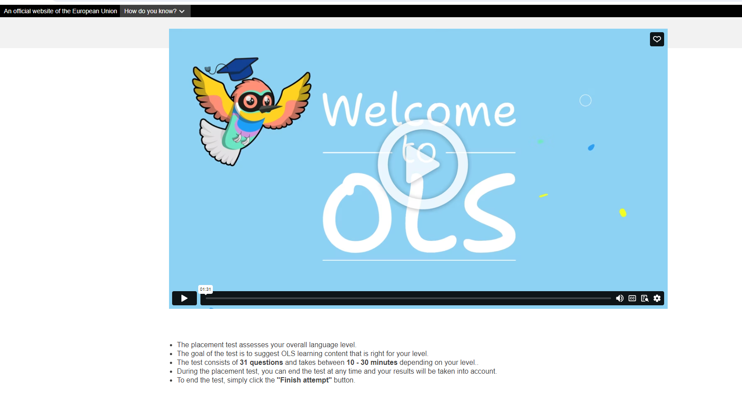
It's FREE!

Slide 17
MOBILITY AGREEMENT
It can only be set one month before departure,
If you have already sent the approved Learning Agreement
Notes:
Terms pf payment

Slide 18
1. FINANCIAL CONTRIBUTIONS
MONTHLY GRANT | DESTINATION COUNTRY: PROGRAMME COUNTRY > EU MEMBER STATES + *
500 | Austria, Belgium, Denmark, Finland, France, Germany, Ireland, Iceland, Luxembourg, Liechtenstein, Norway, Netherlands, Sweden *Partner Countries: Andorra, Monaco, Fær Øer Islands, UK and Switzerland
450 | Cyprus, Estonia, Greece, Latvia, Malta, Portugal, Spain, Czech Republic, Slovakia, Slovenia. Bulgaria, Croatia, North Macedonia, Lithuania, Poland, Romania, Serbia, Hungary, Turkey
MONTHLY GRANT | DESTINATION COUNTRY: PARTNER COUNTRY > EXTRA EU
700 | Partner Countries of Regions 1 to 12 – see list at ART.3 of the Call NO MORE THAN 20% OF THE TOTAL AVAILABLE BUDGET.
+ 250 / MONTH for FEWER OPPORTUNITIES STUDENTS Criteria available at Annex I (Article 4 ) of the Call, published on our website.
Notes:
Gli iscritti a scuole di specializzazione e assegnatari di borsa di specialità potranno beneficiare del contributo comunitario (salvo eventuali casistiche di incompatibilità da verificarsi puntualmente con la U.O.C. Mobilità Internazionale e la U.O.C. Scuole di Specializzazione di Area Sanitaria).
La fruizione del contributo Erasmus è incompatibile con altri fondi comunitari. Le borse di mobilità Erasmus non sono pertanto cumulabili con altri finanziamenti Europei, tra i quali borse PNRR, PON e altri contributi comunitari (fondi su cui, ad esempio, spesso gravano alcune borse di dottorato). I vincitori potranno comunque partecipare al programma rinunciando a tale contributo.

Slide 19
2. FINANCIAL CONTRIBUTIONS - Integration
ISEE | MONTHLY GRANT
ISEE ≤ 13.000 | 400
13.000 < ISEE ≤ 21.000 | 350
21.000 < ISEE ≤ 26.000 | 300
26.000 < ISEE ≤ 30.000 | 250
30.000 < ISEE ≤ 40.000 + Master/ PhDs students wo mobiliy scholarship | 200
40.000 < ISEE ≤ 50.000 | 150
ISEE > 50.000 (or not declared) Enrolled in doctoral courses awarded international mobility scholarships, for the same period and destination, according to the calls issued by the University's doctoral office + Enrolled in specialization schools awarded speciality scholarships | 0
Master /= Master’s degree
Master (1°-2° level): Post graduate diploma or certificate that provides professional specialization. Tipically lasts 1 year.
Table available at Annex I (Article 4) of the Call, published on our website.

Slide 20
3. FINANCIAL CONTRIBUTION - TRAVEL
DESTINATION COUNTRY
ALL THE COUNTRIES | DAILY ALLOWANCE = total monthly grant / 30 days = about 15-20 Euro/day ONLY 1 TRIP FOR EACH DAY OF TRAVEL NECESSARY TO REACH THE FINAL DESTINATION, FOR A MAXIMUM OF 6 DAYS. TRAVEL DAYS ARE NOT PART OF THE PERIODO INDICATED IN THE TRAINEESHIP CERTIFICATE
ONLY PARTNER COUNTRIES REGIONS 1 - 12 | + VARIABLE PART BASED ON TRAVEL DISTANCES ONLY 1 TRIP
Notes:
Rimborso non più per viaggi con mezzi sostenibili.
Rimborso solo per la diaria e fino a un massimo di 6 giorni di viaggio solo per mobilità di lunga durata. No rimborso spese di viaggio.
Diaria: borsa giornaliera / 30

Slide 21
3. FINANCIAL CONTRIBUTION - TRAVEL
DESTINATION COUNTRY
PARTNER COUNTRIES REGIONS 1 - 12 | + VARIABLE PART BASED ON TRAVEL DISTANCES: FLAT PAYMENT ONLY 1 TRIP
The Distance calculator is provided by the European Commission. Calculate the distance between Pavia and the location of the activity 5 The main part of the trip is done by bus and/or train
Notes:
Rimborso non più per viaggi con mezzi sostenibili.
Rimborso solo per la diaria e fino a un massimo di 6 giorni di viaggio solo per mobilità di lunga durata. No rimborso spese di viaggio.
Diaria: borsa giornaliera / 30

Slide 22
3. FINANCIAL CONTRIBUTION - TRAVEL
To those who undertake a mobility period in one of the Programme Countries or in the eligible countries of Regions 13 and 14 to reach the assigned destination (limited to the daily allowance):
Erasmus participants can request a travel refund in terms of daily allowance corresponding to the daily amount related to the monthly grant (i.e., total monthly grant / 30 days = daily allowance entitled, ca 8-12 Euro/day).
The daily allowance will be granted for each day of travel necessary to reach (or return from) the final destination for a maximum of 6 days. Travel days must not be part of the period indicated in the Certificate of Attendance

Slide 23
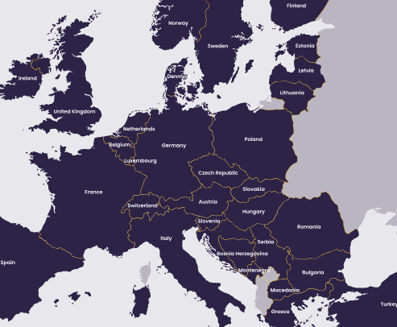
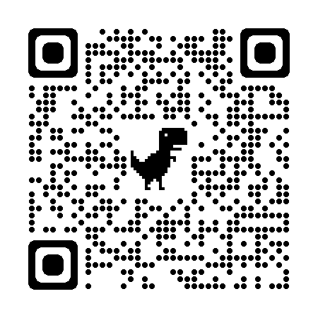
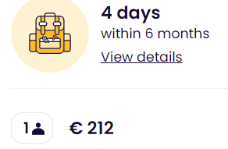
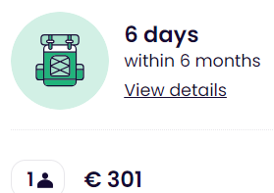
TRAVEL – INTERRAIL PASS for ERASMUS +
A train pass reserved for Erasmus students.
Non-European Erasmus+ participants must be residents in a European country.
It lasts 6 months. Within this period you can travel 4 or 6 days in up to 33 European countries – regional trains. For high speed and night trains, reservation is needed.
The pass allows up to 2 journeys in your home country: 1 to leave, 1 to return - at any stage of your Pass’ validity.

Slide 24
DURING THE MOBILITY
Submit the arrival certificate by the first week after your arrival
If necessary, ask for a mobility extension: extension periods are not covered by the grant

Slide 25
AFTER THE MOBILITY
MANDATORY for everyone:
Traineeship certificate
Final report
> forms on our website
Complete the final OLS test
EU Survey
Deadline for submission:
For undegraduates: at least 45 days before graduation
For recent graduates: by 30 days after your return

Slide 26
HOW TO GET IN TOUCH WITH US?
One-to-one meeting in a virtual room
One-to-one meeting in presence
Wednesdays from 13:30 to 15:00
Fridays from 10:00 to 11:30
(on appointment only)
Tuesdays from 10.30 a.m. to 12.30 p.m.
(on appointment only)
BOOK YOUR FAVOURITE TIME SLOT!
https://internazionale.unipv.eu/en/
Click on «About us» and «Contact»
Choose «In presence» or «Virtual»
Notes:
15 mins time slot to answer all the questions related to the mobility or more general questions
The link to book is available

Slide 27
HOW TO GET IN TOUCH WITH US?
Telegram Group - Live Chat service
Mondays and Thursdays from 10.30 a.m. to 11.30 a.m.
One-to-all approach
Chat history available for new members
Chat open only during those hours
JOIN THE GROUP NOW!
t.me/unipvmobilityout
E-mail Contact
train.erasmus@unipv.it

Slide 28
Thanks for your attention and…
Enjoy your mobility experience!

Slide 29
Q&A?
Check also our FAQs section!

