Slide 2
ERASMUS + Study OVERSEAS Programme
CHECKLIST BEFORE DEPARTURE
WHAT SHALL I DO NOW?
Edited by the International Mobility Unit – APRIL 2024

Slide 3
The Q&A session has been planned at the end.
Please, take note of any questions you have for us!
Notes:
Ciao a tutti - welcome to our presentation on international recruiting and sustainability.

Slide 4
WHAT’S ON THE AGENDA TODAY…
Nomination – Hosting Institution
Application
Learning Agreement
International Mobility Delegates
Financial contributions
Q&A Session

Slide 5
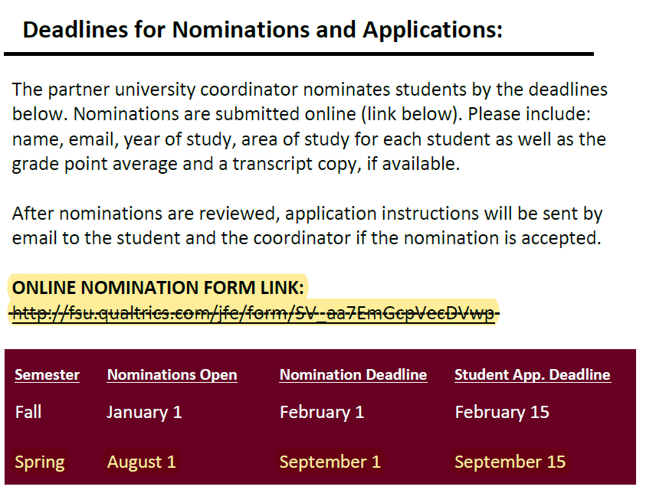
NOMINATION
The International Mobility Unit nominates students to the Receiving Institution.
The Receiving Institution contacts students directly (unless differently specified on their website), providing info about Univ. registration, course catalogue, possible accommodation.
NOTE: if you leave in the II semester,
you'll be contacted later on!!

Slide 6
APPLICATION
After nomination > Application to the Receiving Insitution
Informative email from the Host University
What might be required?
Official Transcript of Records
Certificate of Assignment (or proof of nomination)
Health Insurance policy
Official language certificate (OVERSEAS)
Recommendation letter (OVERSEAS)
Passport (OVERSEAS)
Criminal records and Bank Statement (OVERSEAS)
*
Proof of exemption from linguistic test (Eng) NO Overseas
outgoing.erasmus@unipv.it
Unipv Delegates
Notes:
Email d’esempio, TOR, Assicurazione, Certificati linguistici. OVERSEAS: ricordare che sebbene hanno un certificato del centro linguistico, DEVONO presentare i certificati chiesti dalla sede ospitante

Slide 7
VISA and ENTRY RULES
Inform yourself about entry rules and healthcare assistance
in the host country.
You can rely on:
Host Country Embassy
Host University instructions
https://www.esteri.it/it/
https://www.viaggiaresicuri.it/home
What UniPV can provide:
Certificate of Assignment
Unipv insurance policies (Accident, Civil Liability) NO HEALTH INSURANCE!!

Slide 8
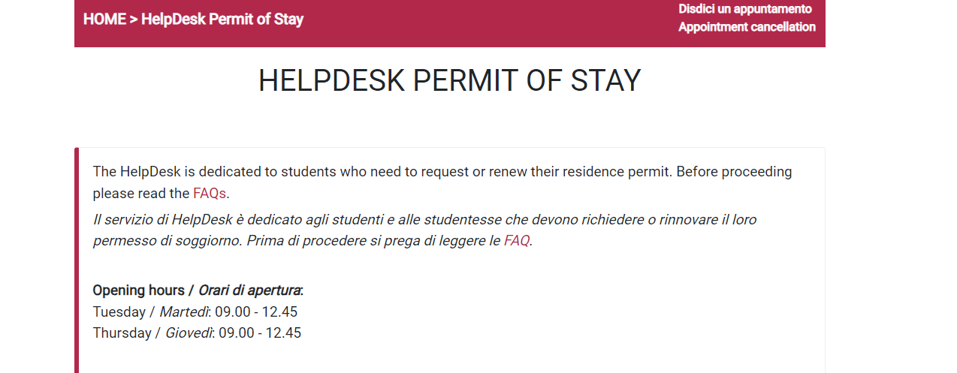
RESIDENCE PERMIT
If you are in Italy with a residence permit, make sure it remains valid for the entire period of mobility abroad. If you need to renew it, take action immediately in preparation for your Erasmus program departure. If you need assistance, contact the dedicated GOPA office: HelpDesk Permit of Stay
Start the renewal process at least 4 months before departure.
Ask the International HelpDesk at Questura offices: GOPA.

Slide 9
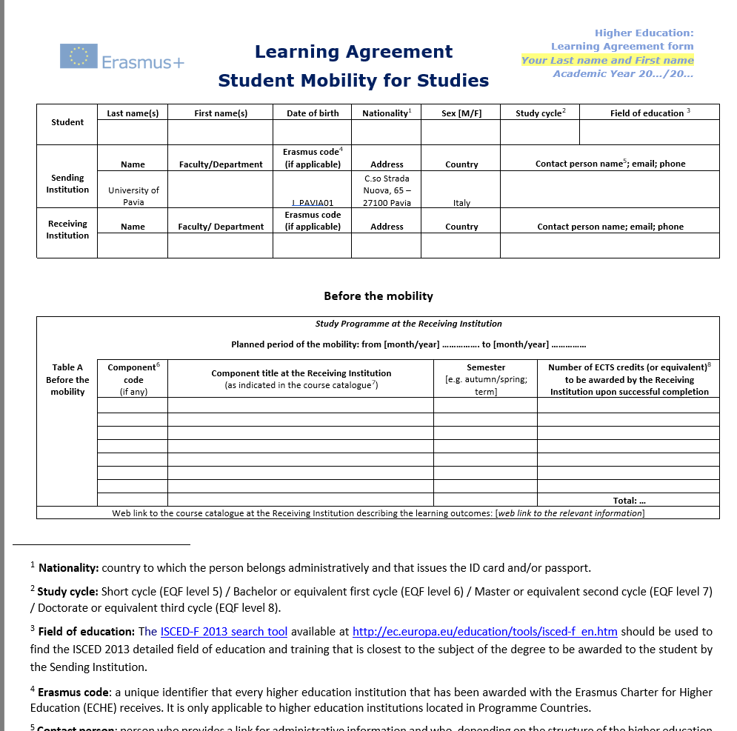
LEARNING AGREEMENT
Download the Learning Agreement form from our website
Select courses from the "course catalogue" of the Receiving Institution > "Before the mobility" section
Select the corresponding courses from your Unipv study plan > "Recognition at the Sending Instituion" section
Contact your International Mobility Coordinator to agree on the Learning Agreement (study program abroad).
Send the signed LA to the International Mobility Office or upload it to Mobility Online
The LA set out the progamme of the activities - courses and/or thesis research - to be followed abroad.
20 CFU
Notes:
20 cfu crediti minimi per Erasmus Studio. Upload su Mobility Online
Tip: Make sure there is a clear connection between your study plan and the courses at the host institution, depending on your starting semester. Consult with the professors of the individual courses to verify if the course content you wish to take is compatible with what is required in your study plan.

Slide 10
LEARNING AGREEMENT
IMPORTANT: the Learning Agreement MUST be approved/signed by you, the UniPV International
Mobility Delegate and the Receiving Institution International Mobility Delegate!
Submission deadline: 1 month before departure - ideally with all 3 signatures, at least with 2 signatures
the student and the Delegate from Unipv.
30 days upon your arrival - the receiveing insitution must approve/sign your Learning Agreement as well and you must send a copy of the fully signed LA!
Where is the form: Erasmus for Study – Before departure

Slide 11
OLA or DLA
ONLINE / DIGITAL LEARNING AGREEMENT:
Upon request to: outgoing.erasmus@unipv.it
This step must be activated
Fill in the form through the platfrom MOBILITY ONLINE
Same principle as PDF version
Notify by email your Delegate once completed
Notes:
Cerchiamo di fare OLA da qs anno. Se la sede ospitante lo richiede o lo accetta facciamo quello

Slide 12
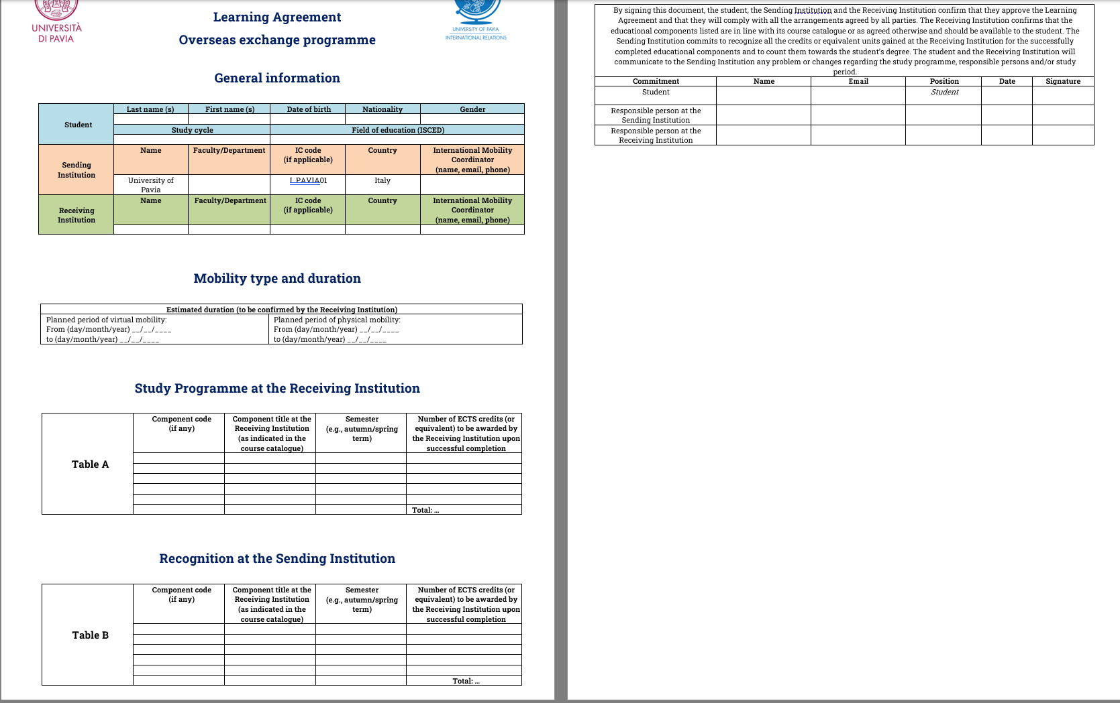
LEARNING AGREEMENT OVERSEAS
Same as Learning Agreement for Studies
20 CFU
IMPORTANT: before departure, make sure the Learning Agreement is signed by you and your Erasmus Delegate at least.
Max. 30 days upon arrival, approval/signature also by the receiveing insitution.
Submit by e-mail: outgoing.erasmus@unipv.it
Notes:
Solo pdf. No OLA. 1 Unit equivale a 2 CFU

Slide 13
INTERNATIONAL MOBILITY COORDIANTOR
https://internazionale.unipv.eu/wp-content/uploads/2024/03/aree-di-studio-e-delegati-2024-25.pdf
Supports students in drafting the Learning Agreement
Is responsible for approving the study plan of the Learning Agreement before departure
Approve changes to the LA during mobility
Is responsible for the academic recognition of the results achieved abroad by the student.
Notes:
Still waiting for the full list of the mobility representatives.

Slide 14
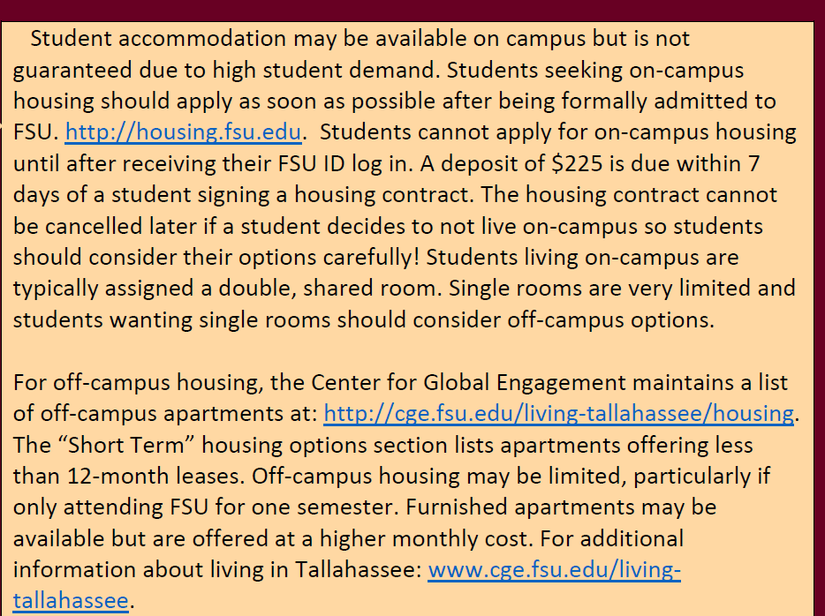
ACCOMMODATION
Seek information from the host University:
on-campus housing / students' residence or a list of accommodations
Contact the local ESN section
If you are looking for accommodation independently, be careful about making
prepayments. Do not accept too high deposits or pay by traceable methods.
https://pavia.esn.it/
https://esn.it/
Notes:
Alloggio di solito presso il college non garantito (generalmente assegnato su base di "first-come-first-serve basis"), invitare a completare application ASAP

Slide 15
FINANCIAL CONTRIBUTIONS
ERASMUS Study - EU
Overseas - Unipv
MONTHLY GRANT | DESTINATION COUNTRY (PROGRAMME COUNTRY)
350 | Austria, Belgium, Denmark, Finland, France, Germany, Ireland, Iceland, Luxembourg, Norway, Netherlands, Sweden and Program Countries: UK and Switzerland
300 | Cyprus, Greece, Malta, Portugal, Spain, Estonia, Czech Republic, Slovakia, Slovenia
250 | Bulgaria, Croatia, North Macedonia, Lithuania, Poland, Romania, Serbia, Hungary, Turkey
MONTHLY GRANT | DESTINATION COUNTRY (PROGRAMME COUNTRY)
400 | Argentina, Brazil, Chile, Colombia, Mexico
700 | Australia, Canada, Japan, USA*
*For ISEP, only the scholarship will be paid, without integration, since the student will already be exmpt from paying board and lodging costs, which will be borne by the hosting Uiversity.
MONTHLY GRANT | DESTINATION COUNTRY (PARTNER COUNTRY)
700 | Morocco, China
+ 250 / MONTH for FEWER OPPORTUNITIES STUDENTS Criteria available at Annex I (Article 6) of the Call, published on our website.

Slide 16
FINANCIAL CONTRIBUTIONS - ERASMUS
ISEE | MONTHLY GRANT
ISEE ≤ 13.000 | 400
13.000 < ISEE ≤ 21.000 | 350
21.000 < ISEE ≤ 26.000 | 300
26.000 < ISEE ≤ 30.000 | 250
30.000 < ISEE ≤ 40.000 / PhDs students wo mobiliy scholarship | 200
40.000 < ISEE ≤ 50.000 | 150
INTEGRATION OF THE SCHOLARSHIP
Unipv
Table available at Annex I (Article 6) of the Call, published on our website.

Slide 17
FINANCIAL CONTRIBUTIONS - OVERSEAS
INTEGRATION OF THE SCHOLARSHIP
Unipv
ISEE | MONTHLY GRANT
ISEE ≤ 13.000 | 550
13.000 < ISEE ≤ 21.000 | 500
21.000 < ISEE ≤ 26.000 | 450
26.000 < ISEE ≤ 30.000 | 400
30.000 < ISEE ≤ 40.000 | 350
40.000 < ISEE ≤ 50.000 | 300
ISEE > 50.000 or not detected | 250
Table available at Annex I (Article 6) of the Call, published on our website.

Slide 18
FINANCIAL CONTRIBUTION - TRAVEL
OVERSEAS: NO TRAVEL CONTRIBUTION
ERASMUS + STUDY:
ONLY DAILY ALLOWANCE REG 1-12 (EU + UK + CH)
DAILY ALLOWANCE + KM CONTRIBUTIN REG 13-14 (MOROCCO and CHINA)

Slide 19
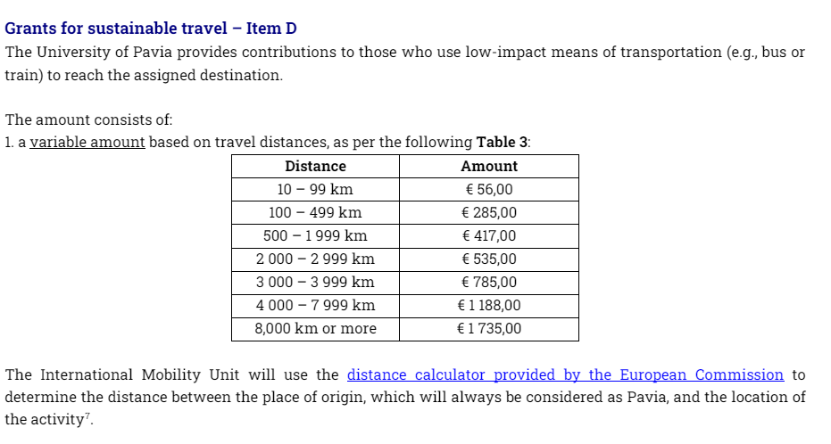
Important Notice
Travel reimbursement with green means is NO LONGER SUPPORTED for Program Countries (EU) and Partners Countries (Switzerland and UK). Grants for sustainable travel – Item D – Table 3 of Annex 1: IT IS NO LONGER APPLICABLE!
Notes:
Chiedere se qualcuno partecipa al DD Marocco e Cina. Per loro Sì a travel grant sia se il viaggio è green o no e sì anche al rimborso giorni di viaggio.

Slide 20
But...
Erasmus participants can request a travel refund in terms of daily allowance corresponding to the daily amount related to the monthly grant (i.e., total monthly grant / 30 days = daily allowance entitled, ca 8-12 Euro/day).
The daily allowance will be granted for each day of travel necessary to reach (or return from) the final destination for a maximum of 6 days. Travel days must not be part of the period indicated in the Certificate of Attendance
Notes:
Rimborso non più per viaggi con mezzi sostenibili.
Rimborso solo per la diaria e fino a un massimo di 6 giorni di viaggio solo per mobilità di lunga durata. No rimborso spese di viaggio.
Diaria: borsa giornaliera / 30

Slide 21
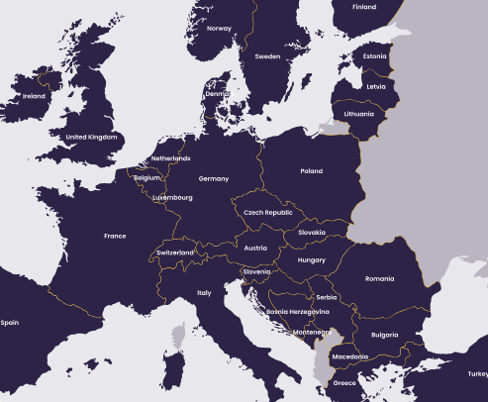
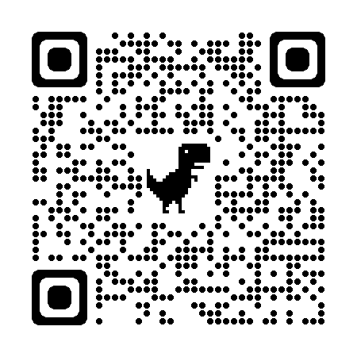
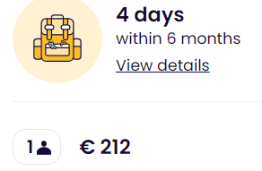
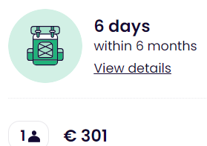
TRAVEL – INTERRAIL PASS for ERASMUS +
A train pass reserved for Erasmus students.
Non-European Erasmus+ participants must be residents of a European country,
Last 6 months. Within this period you can travel 4 or 6 days in up to 33 European countries – regional trains. For high speed and night trains, reservation is needed.
The pass allows up to 2 journeys in your home country: 1 to leave, 1 to return - at any stage of your Pass’ validity.

Slide 22
MOBILITY AGREEMENT
It can only be set one month before departure!
Notes:
Terms pf payment

Slide 23
BANK DETAILS
ERASMUS + STUDY
OVERSEAS EXCHANGE
Enter the bank details of your Italian current account in your Area riservata.
Path: Home>Personal Information>Enter/Modify refund data
If you have a foreign bank account: contact the International Mobility Office: outgoing.erasmus@unipv.it
Fill out the data sheet and return it to the International Mobility Office at least two weeks before your departure
Fill out and sign the payment form
Documents are available at: https://internazionale.unipv.eu/en/mobility/going-abroad/the-overseas-exchange-programme/after-the-selections-overseas/
NB: you must be the account holder or the joint account holder

Slide 24
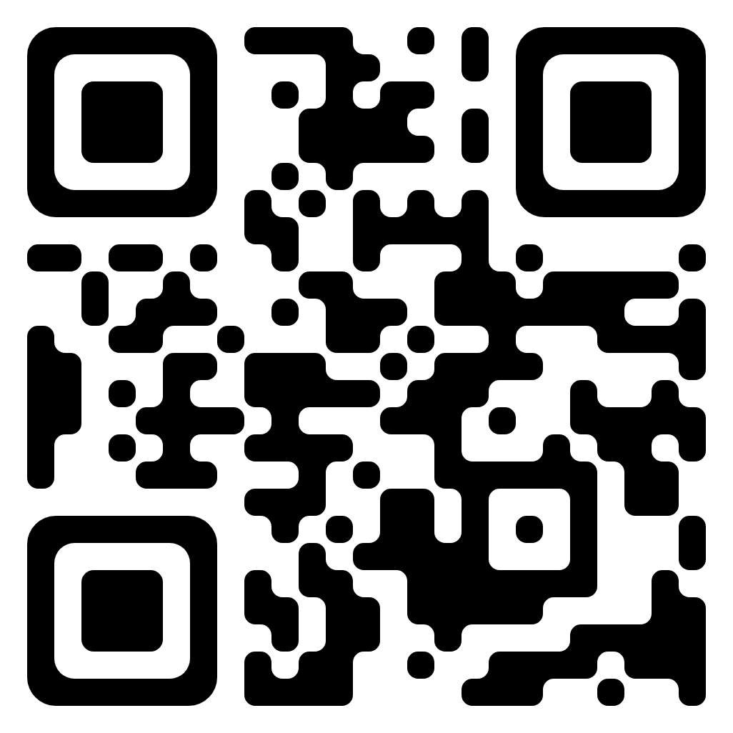
HOW TO GET IN TOUCH WITH US?
One-to-one meeting in a virtual room
One-to-one meeting in presence
Wednesdays from 13:30 to 15:00
Fridays from 10:00 to 11:30
(on appointment only)
Tuesdays from 10.30 a.m. to 12.30 p.m.
(on appointment only)
BOOK YOUR FAVOURITE TIME SLOT!
https://internazionale.unipv.eu/en/
Click on «About us» and «Contact»
Choose «In presence» or «Virtual»
Notes:
15 mins time slot to answer all the questions related to the mobility or more general questions
The link to book is available

Slide 25
HOW TO GET IN TOUCH WITH US?
Telegram Group - Live Chat service
Mondays and Thursdays from 10.30 a.m. to 11.30 a.m.
One-to-all approach
Chat history available for new members
Chat open only during those hours
JOIN THE GROUP NOW!
t.me/unipvmobilityout
E-mail Contact HUB
Erasmus+ for Study, Overseas Exchange Programme, Double Degrees, EC2U Alliance - outgoing.erasmus@unipv.it

Slide 26
Thanks for your attention and..
Enjoy your mobility experience!

Slide 27
Q&A?
Check also our FAQs section!

